Slide 1
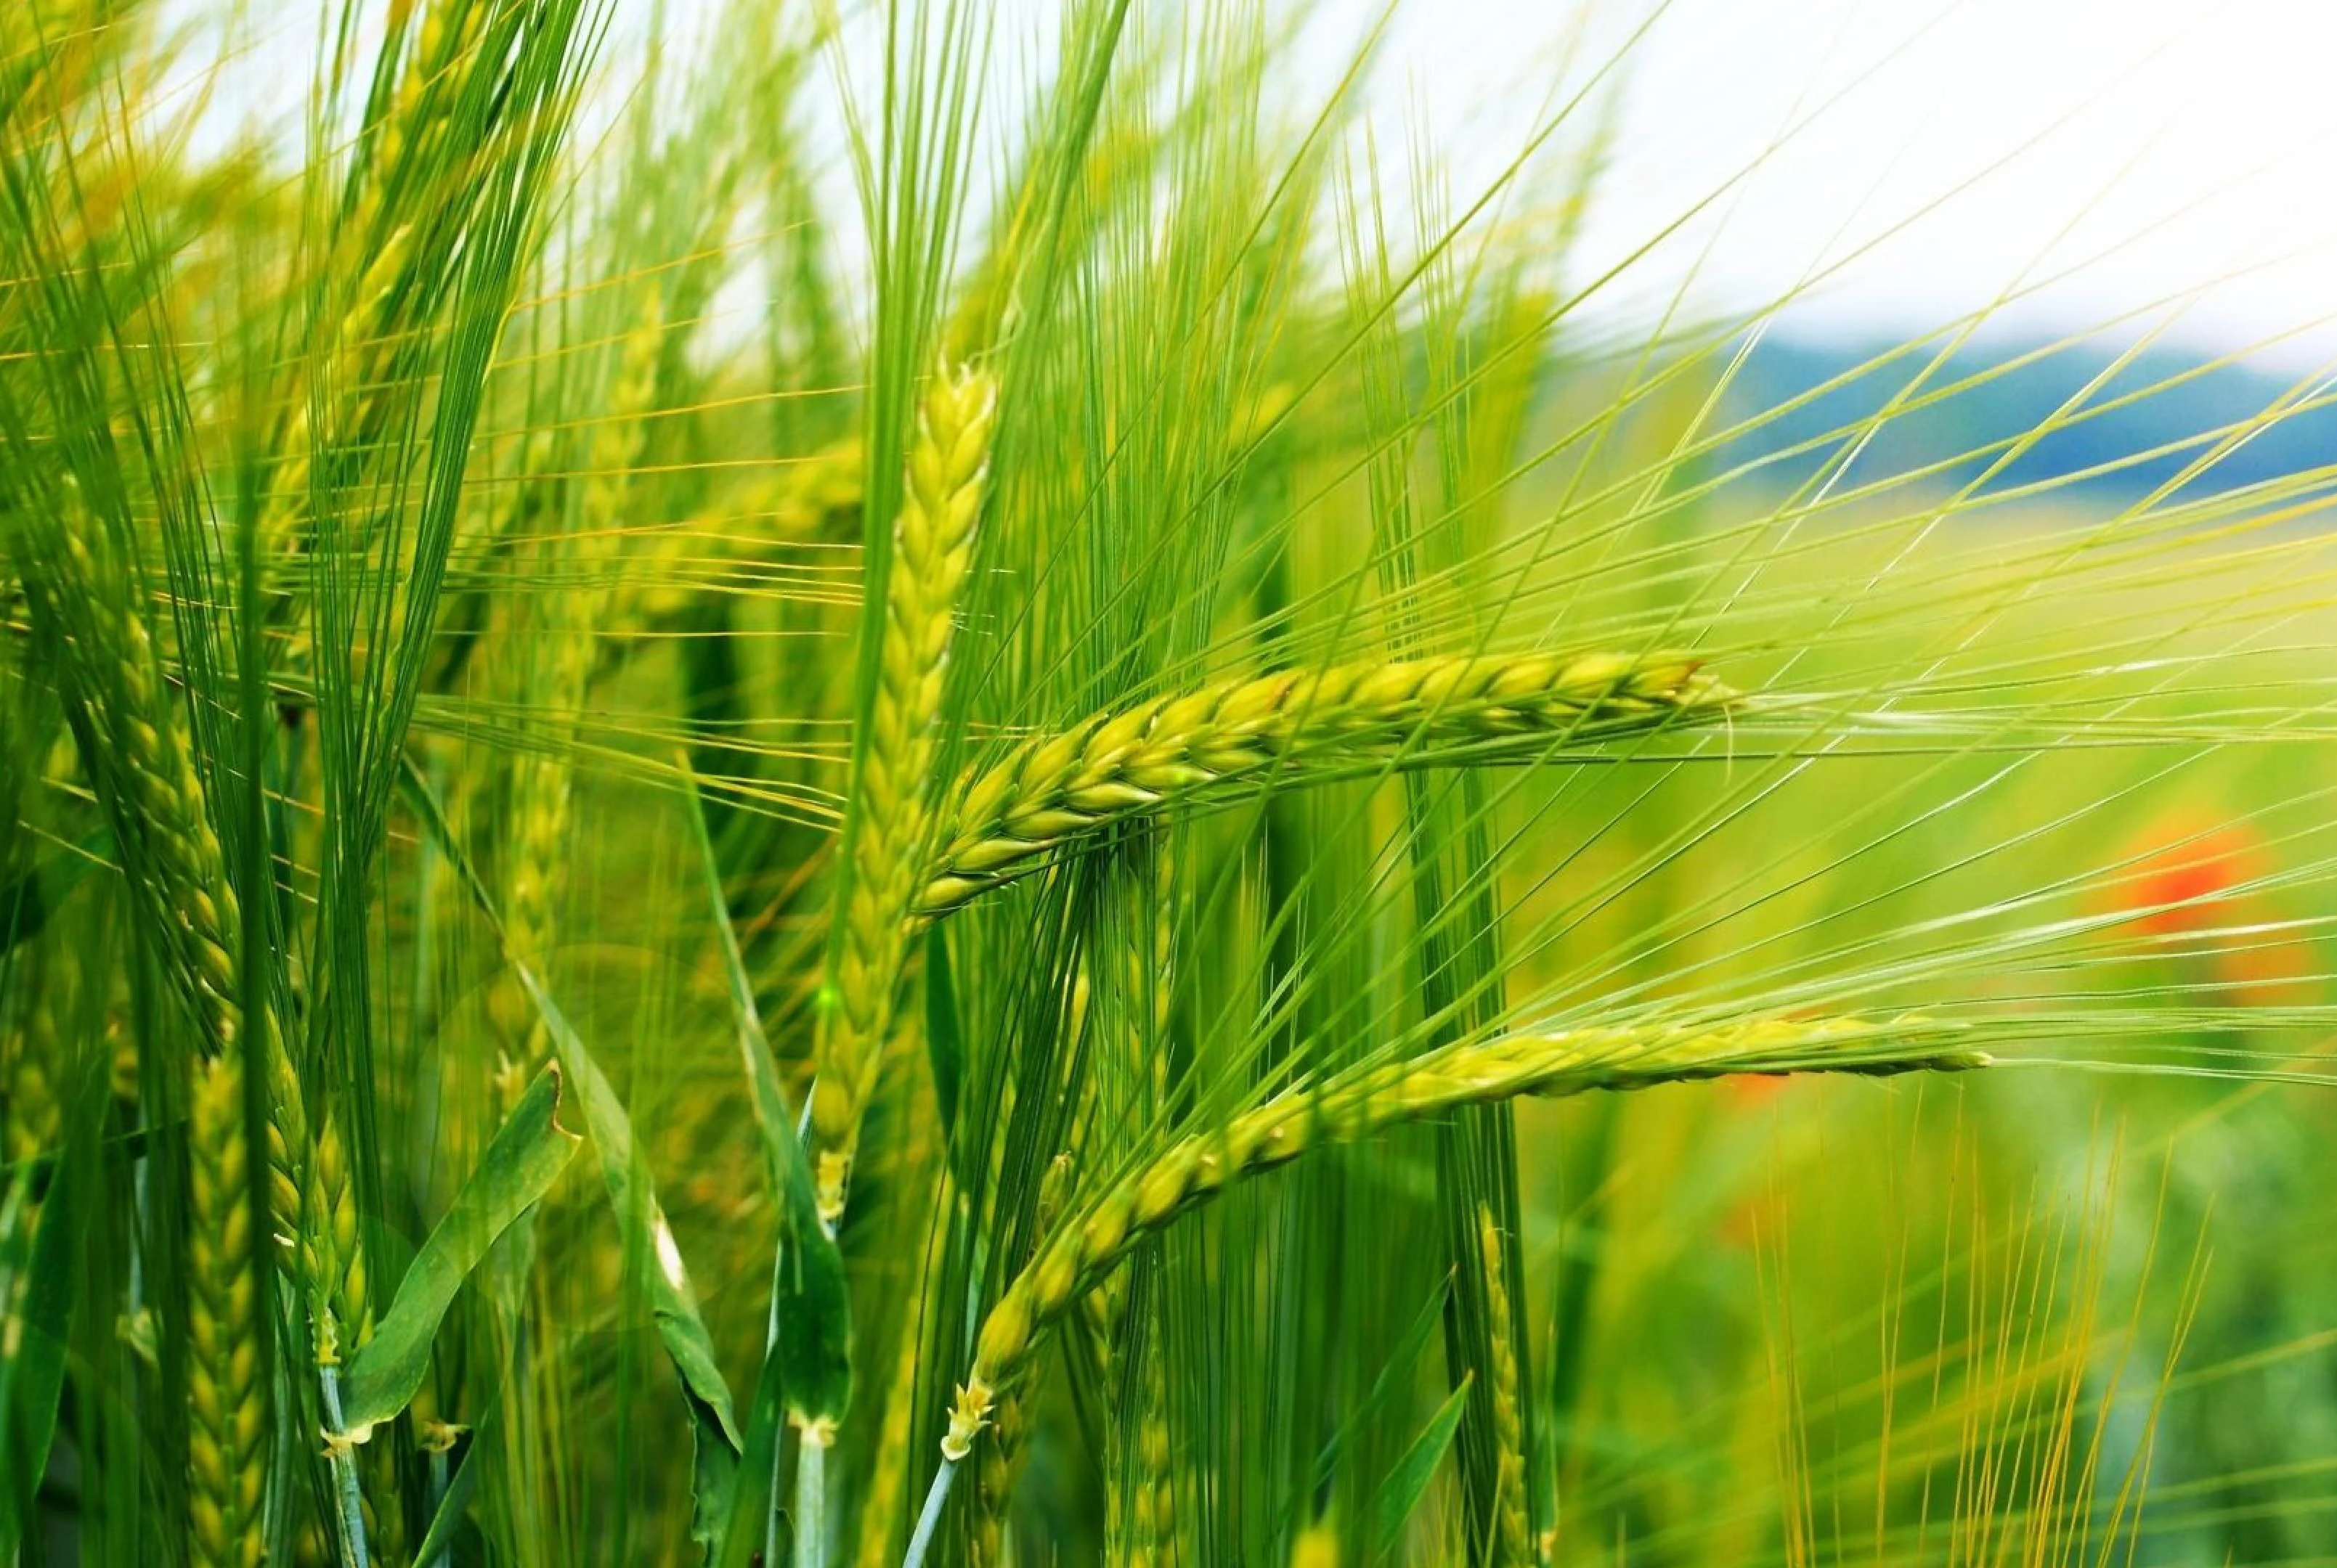
Crop Production Analysis in India
By: Riya Patel
Notes:
NOTE: To change images on this slide, select a picture and delete it. Then click the Insert Picture icon
in the placeholder to insert your own image.

Slide 2
Problem Statement
The Agriculture business domain, as a vital part of the overall supply chain, is expected to highly evolve in the upcoming years via the developments, which are taking place on the side of the Future Internet. This paper presents a novel Business-to-Business collaboration platform from the agri-food sector perspective, which aims to facilitate the collaboration of numerous stakeholders belonging to associated business domains, in an effective and flexible manner. This dataset provides a huge amount of information on crop production in India ranging from several years. Based on the Information the ultimate goal would be to predict crop production and find important insights highlighting key indicators and metrics that influence crop production.
Notes:
NOTE: To change images on this slide, select a picture and delete it. Then click the Insert Picture icon
in the placeholder to insert your own image.

Slide 3
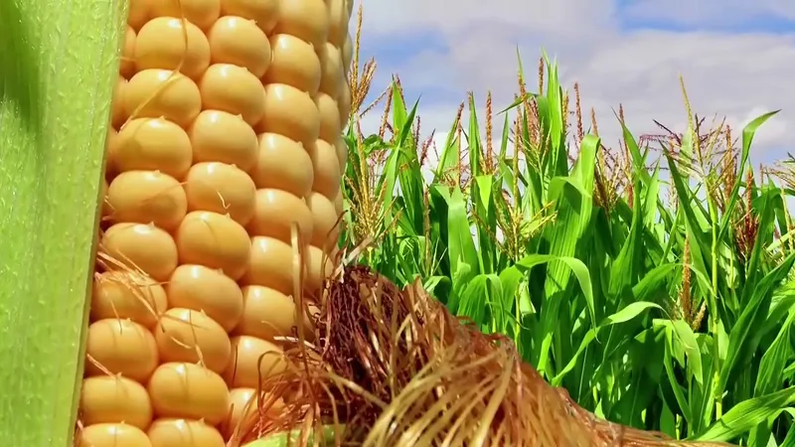
Visualization

Slide 4
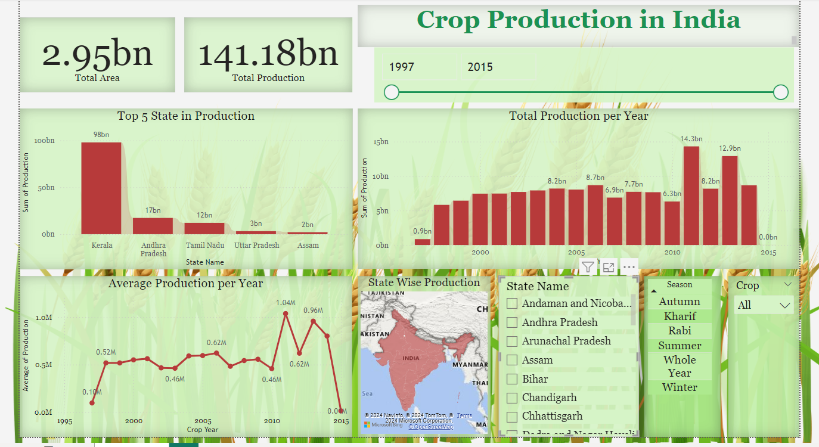

Slide 5
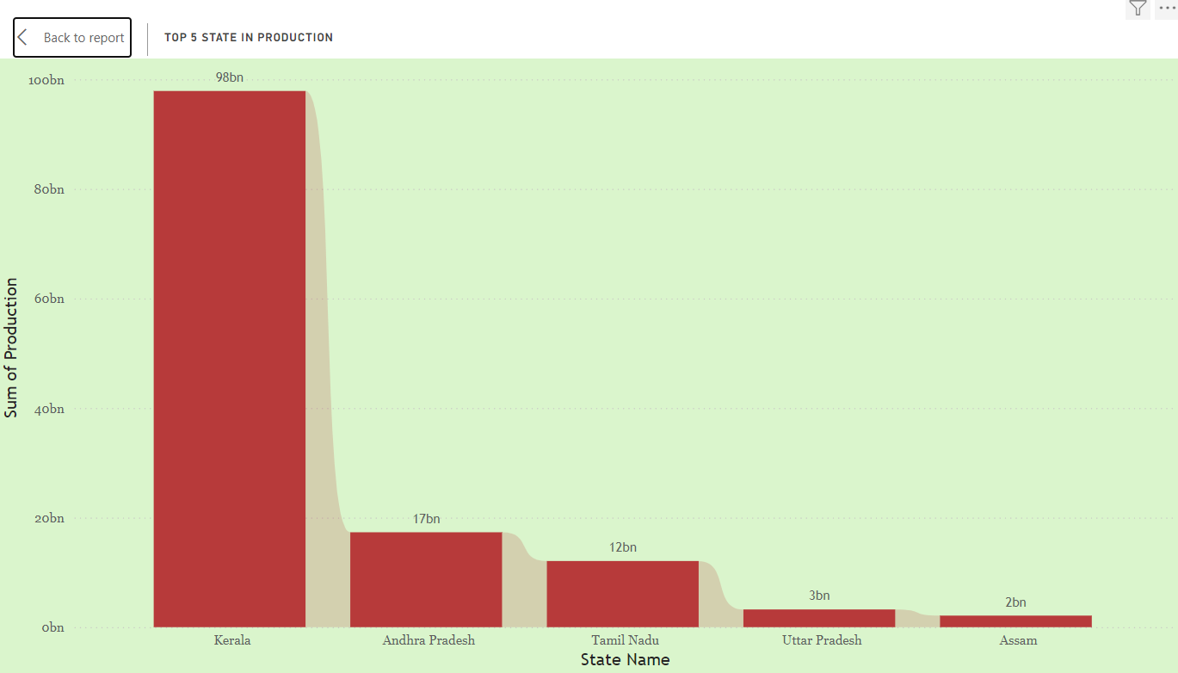

Slide 6
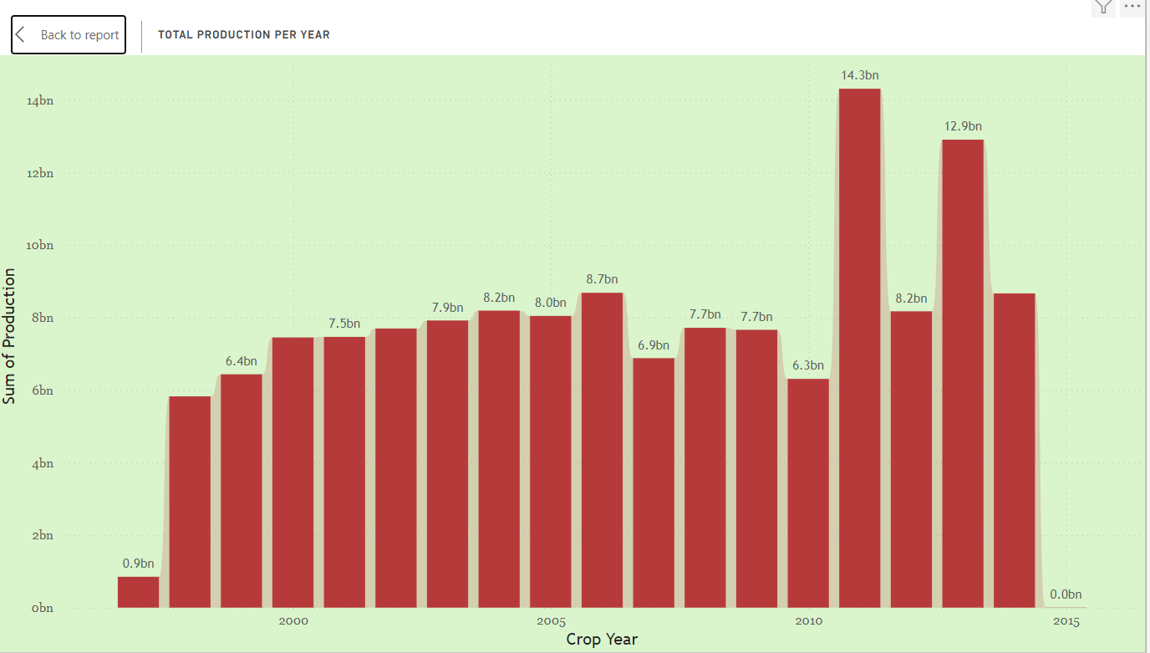

Slide 7
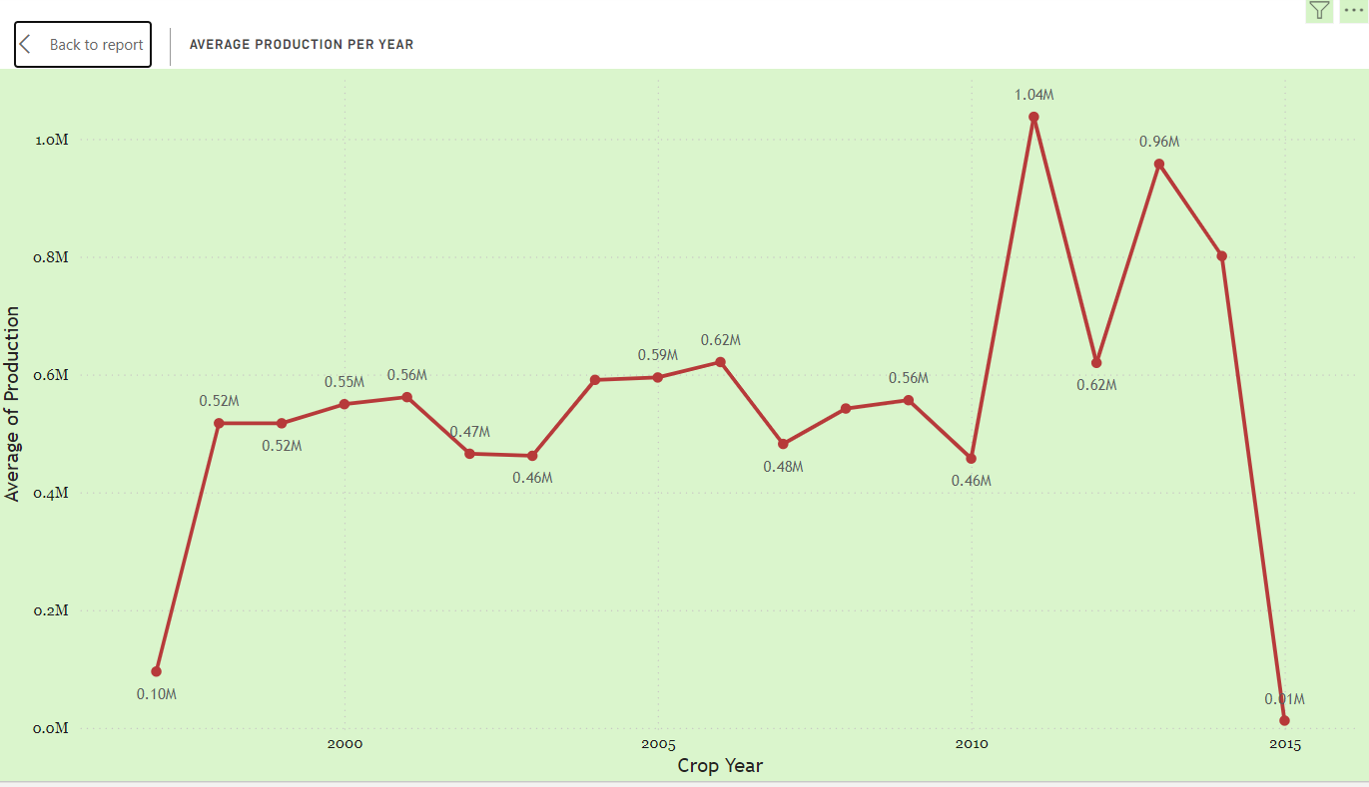

Slide 8

Conclusion
2.95 billion square feet in total
Production total: 141.18 billion
Kerela produces the most, at 98 billion.
2011 produced the most, totaling 14.3 billion.
The average value of the product in 2011 is 1.04 M.
Notes:
NOTE: To change images on this slide, select a picture and delete it. Then click the Insert Picture icon
in the placeholder to insert your own image.

